Slide 1






Credit Card Fraud Detection Using Machine Learning Protecting Digital Payments with Machine Learning
Peer presentation | Fintech Fraud Model

Slide 2
Problem Definition & ML Framing
Credit card fraud is a major problem in finance and results in significant financial losses
The challenge is to automatically identify fraudulent transactions as they occur
Framed as a binary classification problem, where:
0 represents a legitimate transaction
1 represents a fraudulent transaction
Why choose ML?
Manual systems fail to detect evolving fraud patterns
ML can learn complex patterns from historical data

Slide 3
Dataset Overview
The dataset contains 284,807 transactions, but only 492 are fraudulent.
Fraud cases make up only 0.17% of the data
Features:
V1–V28: PCA-transformed variables (anonymised for privacy)
Time: Time since first transaction
Amount: Transaction value
Class: Target variable
Dataset is realistic but very imbalanced, which affects model design

Slide 4
Challenges & Success Metrics
Challenges:
Class imbalance: most transactions are legit so models may ignore fraud cases
False negatives are costly: missing fraud cases leads to financial loss
Chosen Metrics:
Enable data-driven risk management
Recall: ability to detect fraud
Precision: avoid flagging legit transactions
F1-Score: balance of recall and precision
ROC-AUC: overall classification performance

Slide 5
Data Cleaning & Preprocessing
Steps:
Checked for missing values - found none
Removed duplicate records
Investigated outliers in the data
Scaled numeric features: Amount & Time
Performed train-test split
Scaling matters because models like Logistic Regression are sensitive to feature size

Slide 6
Handling Imbalance
Due to the rarity of fraud cases, the following solutions were applied:
Class weighting in the models using SMOTE (Synthetic Minority Oversampling Technique)
Synthetic fraud samples generated
Model bias toward majority class prevented
Outcome:
Fraud detection was improved without major overfitting

Slide 7
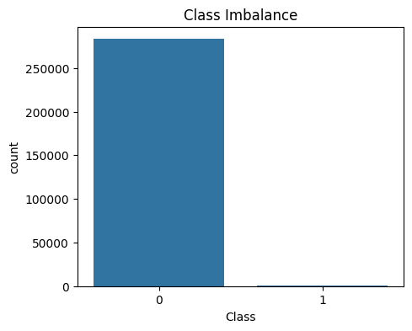
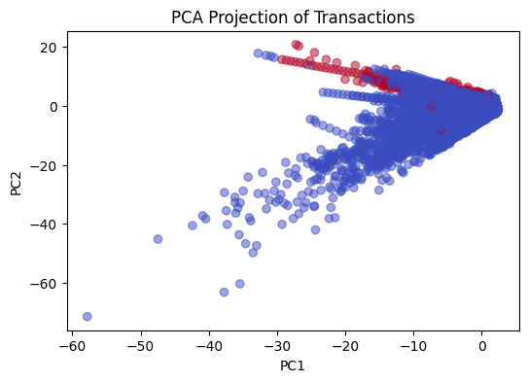
EDA (Exploratory Data Analysis)
Fraud transactions tend to involve lower amounts
Imbalance between fraud and non-fraud visualised on the 1st plot
PCA components show some separation between the classes - visualised on the 2nd plot

Slide 8
Models Implemented
Logistic Regression
Decision Tree
Random Forest
XGBoost
Important to compare performance and robustness of multiple models to find most optimal one
Logistic Regression provides easy intepretability
Tree-based models capture non-linear patterns
XGBoost performs well on imbalanced data

Slide 9
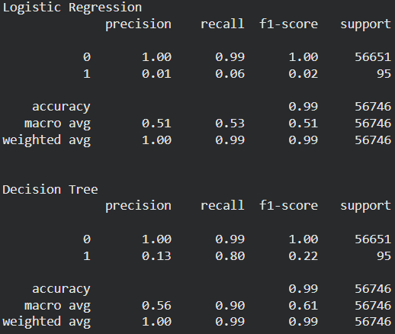
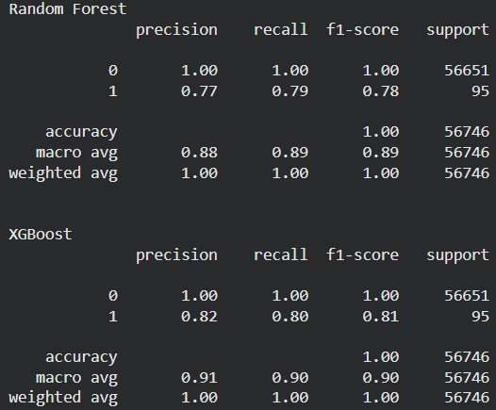
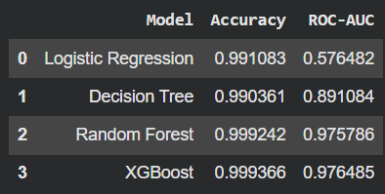
Model Evaluation & Comparison
For evaluation, test data was used
Models compared using:
Precision
Recall
F1-Score
ROC-AUC
Best model is XGBoost due:
High recall (ie best fraud detection) and balanced trade off between false positives & false negatives

Slide 10
Model Explainability
Important for a model to be transparent, especially for financial decisions (lots of regulatory requirements).
ML models need to have levels of good accountability.
SHAP is used to explain how features influence predictions (see SHAP plot on the right)

Slide 11
Ethical AI, Bias & Limitations
Ethical concerns:
False positives inconvenience customers
PCA features reduce human interpretability
Bias Considerations:
No demographic features available
Potential indirect bias through transactions
Mitigations:
Threshold tuning, human review of high-risk cases
Continuous retraining and improvement

Slide 12
Thank You!

